Slide 1
Black-box testing techniques
Durga Prasad Mohapatra
Professor
Dept. of CSE
NIT Rourkela

Slide 2
Boundary Value Analysis

Slide 3
Boundary Value Analysis
Some typical programming errors occur:
at boundaries of equivalence classes
might be purely due to psychological factors.
Programmers often fail to see:
special processing required at the boundaries of equivalence classes.

Slide 4
Boundary Value Analysis
Programmers may improperly use < instead of <=
Boundary value analysis:
select test cases at the boundaries of different equivalence classes.

Slide 5
Example
For a function that computes the square root of an integer in the range of 1 and 5000:
test cases must include the values {0,1,5000,5001} along with the values obtained from Equivalence partitioning.
1
5000

Slide 6
BOUNDARY VALUE ANALYSIS (BVA)
BVA offers several methods to design test cases. Following are the few methods used:
1. BOUNDARY VALUE CHECKING (BVC)
2. ROBUSTNESS TESTING METHOD
3. WORST-CASE TESTING METHOD
4. ROBUST WORST-CASE TESTING METHOD

Slide 7
BOUNDARY VALUE CHECKING (BVC)
In this method, the test cases are designed by holding one variable at its extreme value and other variables at their nominal values in the input domain.
The variable at its extreme value can be selected at:

Slide 8
BOUNDARY VALUE CHECKING (BVC)
(a) Minimum value (Min)
(b) Value just above the minimum value (Min+ )
(c) Maximum value (Max)
(d) Value just below the maximum value (Max−)

Slide 9
BOUNDARY VALUE CHECKING (BVC)
Let us take the example of two variables, A and B.
If we consider all the above combinations with nominal values, then following test cases
(see Fig. 1) can be designed:
1. Anom, Bmin 2. Anom, Bmin+
3. Anom, Bmax 4. Anom, Bmax–
5. Amin, Bnom 6. Amin+, Bnom
7. Amax, Bnom 8. Amax–, Bnom
9. Anom, Bnom

Slide 10
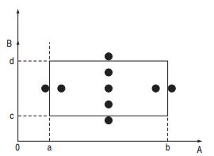
BOUNDARY VALUE CHECKING (BVC)
Fig 1: Boundary Value Checking

Slide 11
BOUNDARY VALUE CHECKING (BVC)
It can be generalized that for n variables in a module, 4n + 1 test cases can be designed with boundary value checking method.

Slide 12
ROBUSTNESS TESTING METHOD
The idea of BVC can be extended such that boundary values are exceeded as: 
1. A value just greater than the Maximum value (Max+)
2. A value just less than Minimum value (Min−)

Slide 13
ROBUSTNESS TESTING METHOD
When test cases are designed considering the above points in addition to BVC, it is called robustness testing.
Let us take the previous example again. Add the following test cases to the list of 9 test cases designed in BVC:
10. Amax+, Bnom 11. Amin–, Bnom
12. Anom, Bmax+ 13. Anom, Bmin–

Slide 14
ROBUSTNESS TESTING METHOD
It can be generalized that for n input variables in a module, 6n + 1 test cases can be designed with robustness testing.

Slide 15
WORST-CASE TESTING METHOD
We can again extend the concept of BVC by assuming more than one variable on the boundary.
It is called worst-case testing method.
Again, take the previous example of two variables, A and B. We can add the following test cases to the list of 9 test cases designed in BVC as:

Slide 16
WORST-CASE TESTING METHOD
10. Amin, Bmin 11. Amin+, Bmin
12. Amin, Bmin+ 13. Amin+, Bmin+
14. Amax, Bmin 15. Amax–, Bmin
16. Amax, Bmin+ 17. Amax–, Bmin+
18. Amin, Bmax 19. Amin+, Bmax
20. Amin, Bmax– 21. Amin+,Bmax–
22. Amax, Bmax 23. Amax–, Bmax
24. Amax, Bmax– 25. Amax–,Bmax–

Slide 17
WORST-CASE TESTING METHOD
It can be generalized that for n input variables in a module, 5^{n} test cases can be designed with worst-case testing.

Slide 18
ROBUST WORST-CASE TESTING METHOD
In the previous method, the extreme values of a variable considered are of BVC only.
The worst case can be further extended if we consider robustness also, that is,
in worst case testing if we consider the extreme values of the variables as in robustness testing method covered in Robustness Testing

Slide 19
ROBUST WORST-CASE TESTING METHOD
Again take the example of two variables, A and B. We can add the following test cases to the list of 25 test cases designed in previous section.
26. Amin-, Bmin- 28. Amin, Bmin-
27. Amin-, Bmin 29. Amin-, Bmin+
30. Amin+, Bmin- 31. Amin-, Bmax

Slide 20
32. Amax, Bmin- 33. Amin-, Bmax-
34. Amax-, Bmin- 35. Amax+,Bmax+
36. Amax+, Bmin 37. Amin, Bmin+
38. Amax+, Bmin+ 39. Amax+,Bmax+
40. Amax+,Bmax 41. Amax, Bmax+
42. Amax+,Bmax- 43. Amax-, Bmax+
44. Amax+,Bnom 45. Anom, Bmax+
46. Amin-,Bnom 47. Anom, Bmin-
48. Amax+,Bmin- 49. Amin-, Bmax+

Slide 21
Example
A program reads an integer number within the range [1,100] and determines whether it is a prime number or not. Design test cases for this program using BVC, robust testing, and worst-case testing methods.

Slide 22
Test cases using BVC
Since there is one variable, the total number of
test cases will be 4n + 1 = 5.
In our example, the set of minimum and maximum values is shown below:

Slide 23
Min value = 1
Min+ value = 2
Max value = 100
Max– value = 99
Nominal value = 50–55

Slide 24
Using these values, test cases can be designed as shown below:
Test Case ID | Integer Variable | Expected Output
1 | 1 | Not a prime number
2 | 2 | Prime number
3 | 100 | Not a prime number
4 | 99 | Not a prime number
5 | 53 | Prime number

Slide 25
Test cases using robust testing
Since there is one variable, the total number of test cases will be 6n + 1 = 7. The set of boundary values is shown below:

Slide 26
Min value = 1
Min– value = 0
Min+ value = 2
Max value = 100
Max− value = 99
Max+ value = 101
Nominal value = 50–55

Slide 27
Using these values, test cases can be designed as shown below:
Test Case ID | Integer Variable | Expected Output
1 | 0 | Invalid input
2 | 1 | Not a prime number
3 | 2 | Prime number
4 | 100 | Not a prime number
5 | 99 | Not a prime number
6 | 101 | Invalid input
7 | 53 | Prime number

Slide 28
Test cases using worst-case testing
Since there is one variable, the total number of test cases will be 5^{n} = 5.
Therefore, the number of test cases will be same as BVC.

Slide 29
Example
A program computes a^{b} where a lies in the range [1,10] and b within [1,5].
Design test cases for this program using BVC, robust testing, and worst-case testing methods.

Slide 30
Test cases using BVC
Since there are two variables, a and b, the total number of test cases will be 4n + 1 = 9. The set of boundary values is shown below:
 | a | b
Min value | 1 | 1
Min+ value | 2 | 2
Max value | 10 | 5
Max− value | 9 | 4
Nominal value | 5 | 3

Slide 31
Using these values, test cases can be designed as shown below:
Test Case ID | a | b | Expected Output
1 | 1 | 3 | 1
2 | 2 | 3 | 8
3 | 10 | 3 | 1000
4 | 9 | 3 | 729
5 | 5 | 1 | 5
6 | 5 | 2 | 25
7 | 5 | 4 | 625
8 | 5 | 5 | 3125
9 | 5 | 3 | 125

Slide 32
Test cases using robust testing
Since there are two variables, a and b, the total number of test cases will be 6n + 1 = 13.
The set of boundary values is shown below:
 | a | b
Min value | 1 | 1
Min– value | 0 | 0
Min+ value | 2 | 2
Max value | 10 | 5
Max+ value | 11 | 6
Max− value | 9 | 4
Nominal value | 5 | 3

Slide 33
Using these values, test cases can be designed as shown below:
Test Case ID | a | b | Expected output
1 | 0 | 3 | Invalid input
2 | 1 | 3 | 1
3 | 2 | 3 | 8
4 | 10 | 3 | 1000
5 | 11 | 3 | Invalid input
6 | 9 | 3 | 729
7 | 5 | 0 | Invalid input
8 | 5 | 1 | 5
9 | 5 | 2 | 25
10 | 5 | 4 | 625
11 | 5 | 5 | 3125
12 | 5 | 6 | Invalid input
13 | 5 | 3 | 125

Slide 34
Test cases using worst-case testing
Since there are two variables, a and b, the total number of test cases will be 5^{n} = 25.
The set of boundary values is shown below:
 | a | b
Min value | 1 | 1
Min+ value | 2 | 2
Max value | 10 | 5
Max− value | 9 | 4
Nominal value | 5 | 3

Slide 35
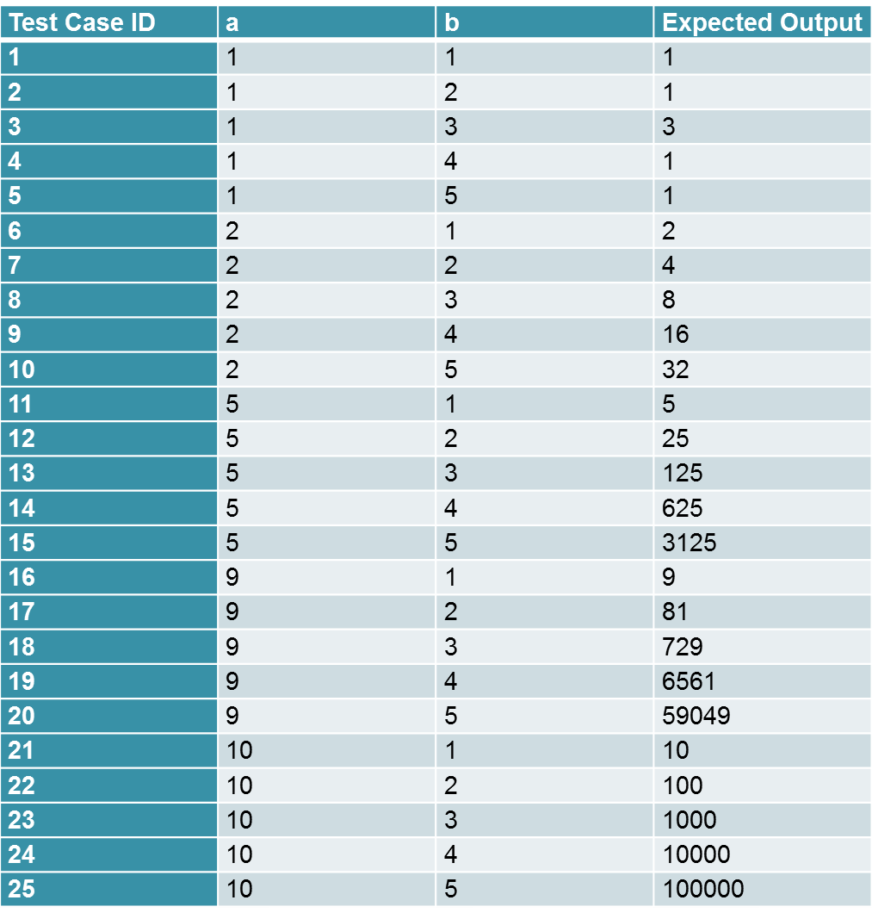
There may be more than one variable at extreme values in this case. Therefore, test cases can be designed as shown below :

Slide 36
Summary
We discussed black-box test case design using:
boundary value analysis
Explained BVA with some examples.

Slide 37
References
Rajib Mall, Fundamentals of Software Engineering, (Chapter – 10), Fifth Edition, PHI Learning Pvt. Ltd., 2018.
Naresh Chauhan, Software Testing: Principles and Practices, (Chapter – 4), Second Edition, Oxford University Press, 2016.

Slide 38
Thank You

